Slide 1
Chapter 1
Introduction to Database Management

Slide 2
Welcome!
Database technology: crucial to the operation and management of modern organizations
Major transformation in computing skills
Significant time commitment
Exciting journey ahead

Slide 3
Outline
What is a database?
Database Management System
Architectures
Organizational roles

Slide 4
Initial Vocabulary
Data: raw facts about things and events
  Employee data: name, salary, address
  Images, videos, maps
Information: transformed data that has value for usage
  Summarized data/ reports
Essential to organize data for retrieval and maintenance
Notes:
Most organizations have a flood of data (too much data is the problem); web proliferation has greatly multiplied the amount of data
Conventional facts: names, DOBs, salaries, interest rates, codes (major)
Unconventional facts: images, engineering drawings, maps, product videos, fingerprints, time series (useful for forecasting), web page
Distinction sometimes made between data and information: raw facts need interpretation, combination, formatting, etc. to be useful for decision making

Slide 5
How to store data in a computer?
Word processing document
Spread sheet document
File
Database

Slide 6
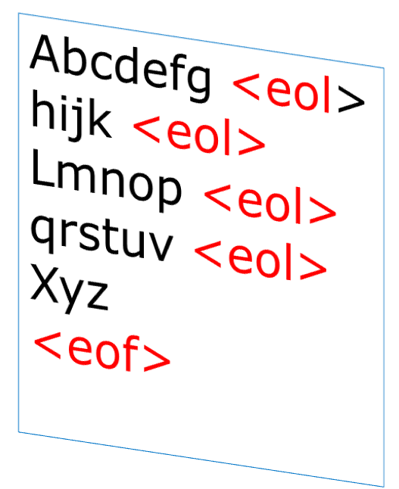
Text Document
String of characters separated by <end of line>
End with <end of file>
Images, graph
Operation?

Slide 7
Spread sheet
Format
  Table
  Limited number of rows and columns
Operation ?
 | A | B | C | D | E | F
1
2 |  | ID | Name | Grade
3 |  | 1 | Tom | 3.0
4 |  | 2 | Sarah | 3.5
5 |  |  |  | =average(d3:d4)

Slide 8
File of records
Collection of records
Stored in a secondary storage (permanent)
Operation
  High level language
  Create,
  Open, close
  Update, insert, delete
<header>
1 | Tom | 3.0
2 | Sarah | 3.5
<eof>
Bits bytes fields records files

Slide 9
File approach
A file definition is declared in an application program
Limited data sharing

Slide 10




Accessing files
Duplicate data
Customer name, address,
Savings accounts
Savings
File
Savings
Applications
Customer name, address,
Loan accounts
Loan
File
Loan
Applications
EXE programs

Slide 11
Limitations of File processing
Requires extensive programming in third-generation language
Limitation of data sharing among programs
High maintenance costs such as ensuring data consistency and controlling access
Sharing granularity is very coarse.
Weak security.

Slide 12
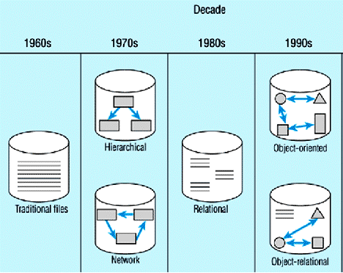
The Evolution of Database
1960s, File based approach
1970s, Database approach
Notes:
http://oracledba.ezpowell.com/odbms/ObjectsVSRelational.html

Slide 13
A database : A self describing collection of interrelated data
A database is self describing
A database is a collection of interrelated data

Slide 14
Bits bytes fields records files
Bits bytes fields records files +
Metadata,
Indices,
Application
Metadata
Database

Slide 15


Example: Relational Database
Data
Data Dictionary

Slide 16

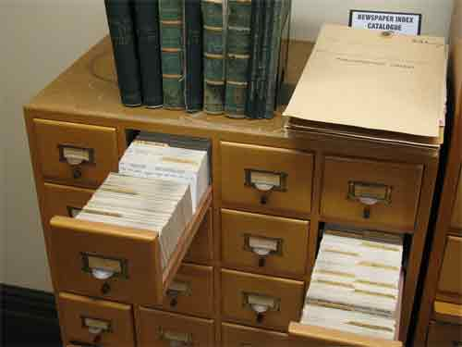
Books
(Data)
Index cards
(Metadata)

Slide 17
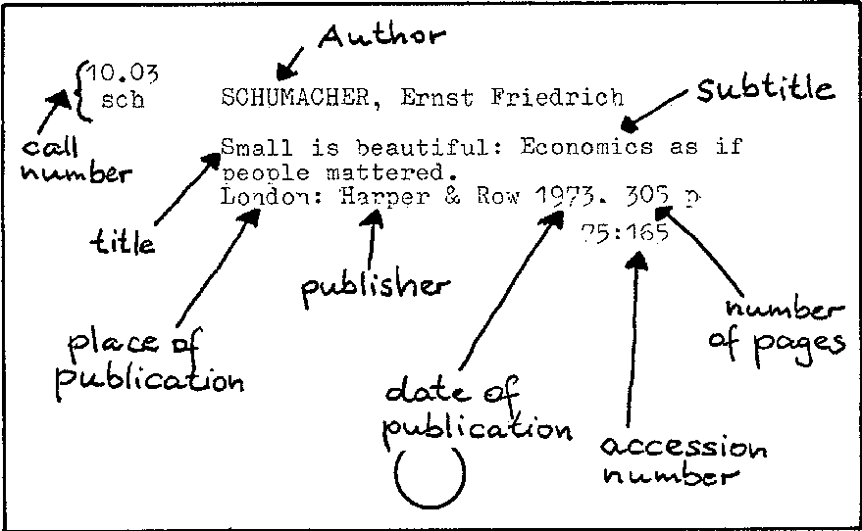
Location of this book
Index Card
Metadata of a book

Slide 18
A database is self describing
contain Data Dictionary (Metadata)
  Information of data files e.g.,
    Structures of each file
    Column names and data types
  Data about Indices
  Data about application
Notes:
a database should have an identity separate from the applications (computer programs, forms, and reports) that use it.
The separate identity allows the database definition to be changed without affecting related applications.

Slide 19
Indices
Water-User Table
ID FirstName LastName Address Province MeterNo
101 Tom Cruise 1/111 01 3815
102 Tom Smith 355 01 3802
103 Sarah Lin 2 22 4125
104 Richard Wong 155 22 4389
1
2
3
4
Record Address
ID Index
Province Index
ID Address
101 1
102 2
103 3
104 4
Province Address
01 2,4
22 1,3

Slide 20
The Database
User Data
ID FirstNaทe LastName Address Province MeterNo
101 Tom Cruise 1/111 01 3815
102 Tom Smith 355 01 3802
103 Sarah Lin 2 22 4125
104 Richard Wong 155 22 4389

Slide 21
Data Dictionary (Metadata)
Systables Table
Table Name Number of Columns Primary Keys
WaterUser 6 ID
Province 3 Code
Syscolumns Table
Column Name Table Name DataType Length
ID ElectricUser Number 3
Name ElectricUser Text 25
…….
SysIndexes SysKeys SysProcedure SysUsers SysReference ….

Slide 22
Application Metadata
Stored procedure/function
Query
Form
Report
Procedure Print_transcript
…….
…….
…….
Programming Codes

Slide 23
DBMS
Database:
Data+Data dict
Procedure
Print_transcript
…….
…….
…….
Make a change here
Application
Graduate School
Applications
Registration office
Call Print_transcript
Call Print_transcript
Changing the transcript format will be done in the database
No need to modify applications

Slide 24
Data Dictionary (Metadata)
  Updated automatically by DBMS
    Ex.
      when a file/table is updated
Notes:
a database should have an identity separate from the applications (computer programs, forms, and reports) that use it.
The separate identity allows the database definition to be changed without affecting related applications.

Slide 25
Database Characteristics
Persistent
- Lasts a long time
- Relevance of intended usage: only store potentially relevant data
Inter-related:
- Entity: cluster of data about a topic (customer, student, loan)
- Relationship: connection among entities
Shared:
- Multiple applications: hundreds to thousands of data entry screens and reports
- Multiple users: many people simultaneously use a database

Slide 26
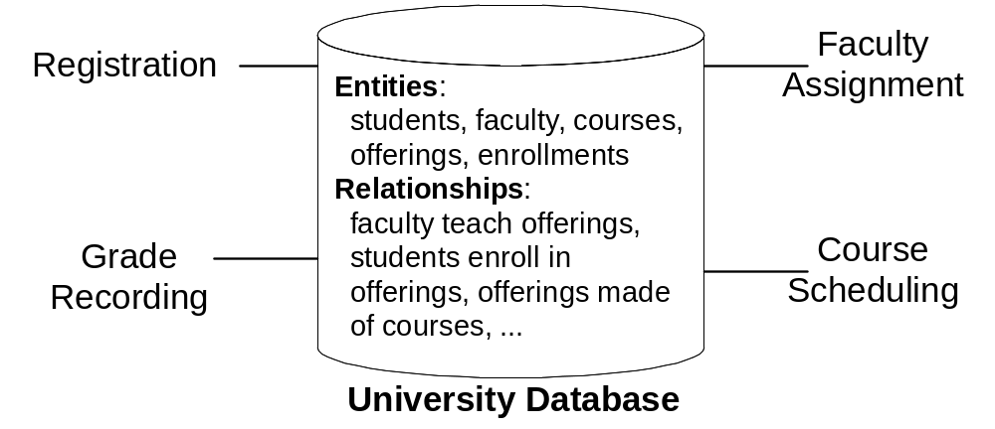
University Database
Applications
Applications
Notes:
To depict these characteristics, let us consider a number of databases. We begin with a simple university database (Figure 1) since you have some familiarity with the workings of a university. A simplified university database contains data about students, faculty, courses, course offerings, and enrollments. The database supports procedures such as registering for classes, assigning faculty to course offerings, recording grades, and scheduling course offerings. Relationships in the university database support answers to questions such as
· What offerings are available for a course in a given academic period?
· Who is the instructor for an offering of a course?
· What students are enrolled in an offering of a course?

Slide 27
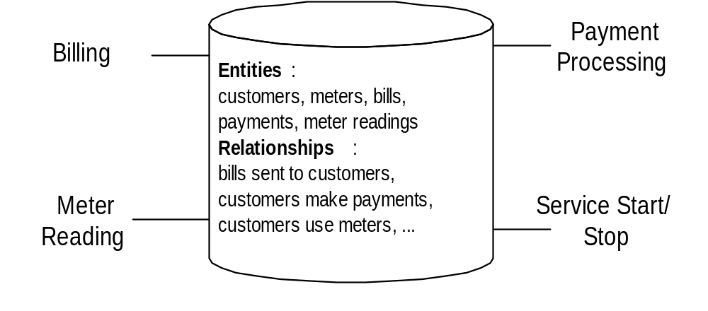
Water Utility Database
Applications
Applications
Database
Notes:
Persistency: long term memory for customer interactions (water usage, billing, payments, repair); triggered by service stop/starts;
Functions: billing, payment processing, meter reading, service; functions are rather complex
Many simultaneous users
Relationships provide glue among entities: connect customer to meter, bills, and payments; complex database (hundreds of entities and relationships)

Slide 28
Database accessing
Database
Database
Applications
DBMS
DBMS
Query Tools

Slide 29
Application Development
Database design
  Requirement analysis
  Data Modeling
Create database
  Tables, columns, data types, indices
Develop applications
  SW design
  Programming
DBMS

Slide 30
Database Design
Define database before using
  Tables and relationships
  Use SQL CREATE TABLE statement
Graphical tools

Slide 31
Data Modeling
Network database
Hierarchical database
Relational database
Object-oriented database
Object-relational database

Slide 32
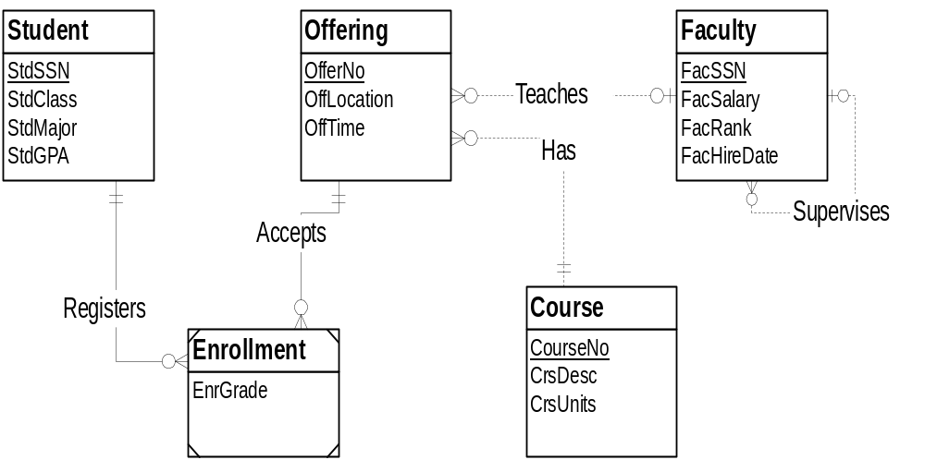
Entity Relationship Diagram
(University Database)
Notes:
University Database diagram drawn with an external tool (Visio Professional);
Learn Entity Relationship Diagrams in second part of course
- Entity: similar to a table
- Relationship: connection among entities with names and connection symbols
Can use third party tools for database definition

Slide 33
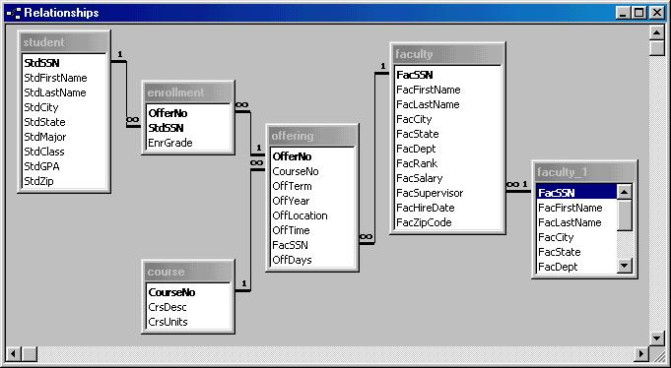
University Database
Notes:
Access relationship window
5 tables (student, enrollment, course, offering, faculty): faculty_1 is not a real table (details later)
Relationships: lines connecting tables (faculty to offering); not all tables are directly connected
Must define the tables and relationships before entering data and retrieving data

Slide 34
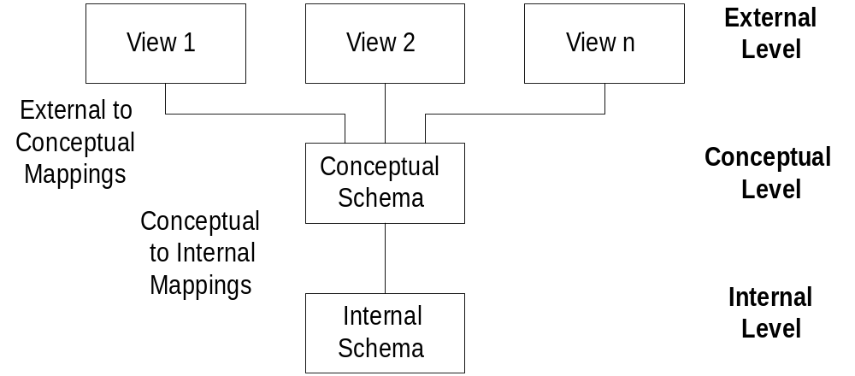
Three Schema Architecture
A transcript:
student+course
Salary payment:
professor+salary
Table student
Table Course
Table Professor
Physical database: index types, data location: cloud, server
Notes:
Three schema architecture:
- Schema: database description
- Reference architecture for compartmentalizing database descriptions
Schema levels:
- Conceptual level: base tables
- External level: views
- Internal level: implementation details for base tables (indexes, disk extents, clustering)
- Chapter 10 for physical database design
Mappings:
- Performed by the DBMS: relieve user of much work
- External to Conceptual: submit query using a view; DBMS translates to base tables
- Conceptual to Internal: SELECT statement implemented with loops, join order, index
usage, …
Reduce impact of changes:
- Use views rather than base tables in applications
- DBMS translates queries on a view to query on lower level schema

Slide 35
Application Development
DBMS provides
  Tools for creating applications
  Languages for creating and manipulating data
    Procedural
    Non-procedural
No extensive coding

Slide 36
Tools for Application Development
Form: formatted document for data entry and display
Report: formatted document for display
Use nonprocedural access to specify data requirements of forms and reports

Slide 37
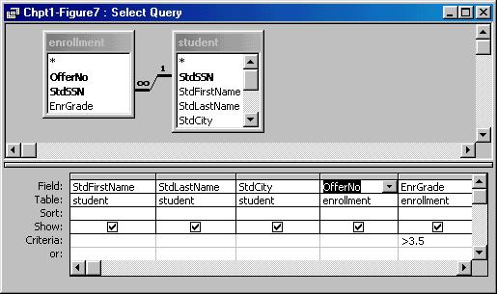
Graphical Tool for Nonprocedural Access
EnrGrade > 3.5
Notes:
Query Design (Access)
- specify tables and columns
- Access determines connections among tables

Slide 38
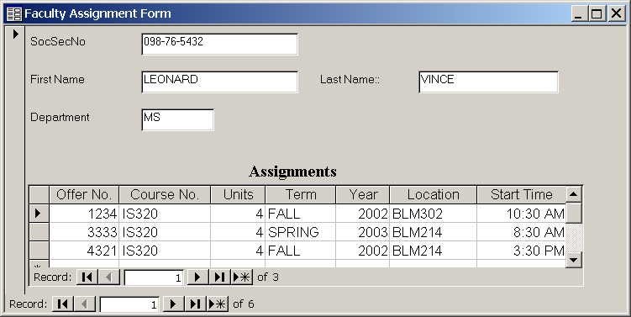
Sample Data Entry Form
Notes:
Faculty assignment form
The form can be used to add new course assignments for a professor and to change existing assignments.

Slide 39
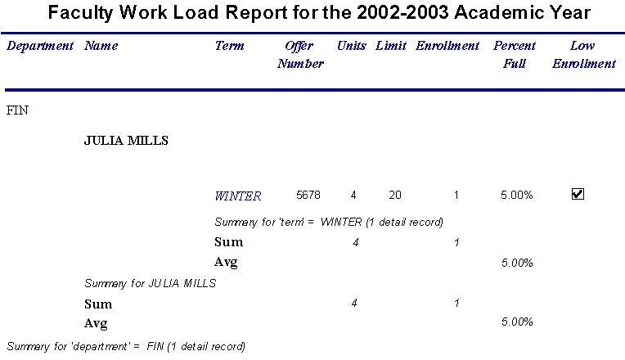
Sample Report
Notes:
The report uses indentation to show courses taught by faculty in various departments. The indentation style can be easier to view than the tabular style shown as default output style.

Slide 40
Nonprocedural language
SQL language
  Structural Query Language
  Create tables
  Insert, update, delete data
  Retrieve data
Query: request for data to answer a question
  Indicate what parts of database to retrieve not the procedural details
  Improve productivity and improve accessibility

Slide 41
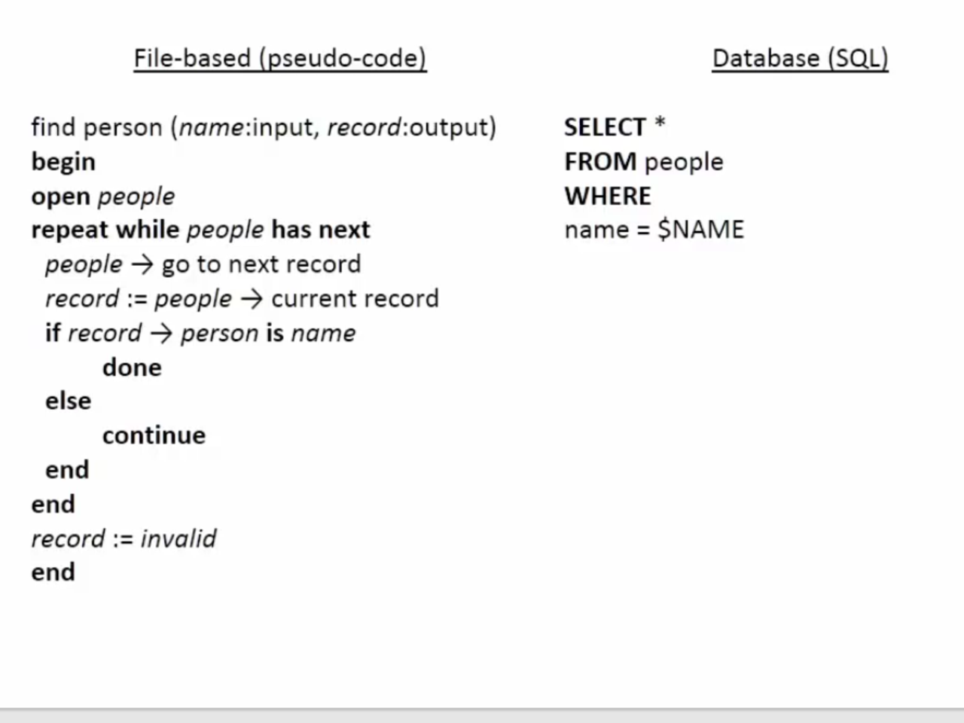
Nonprocedural language
Loop

Slide 42
Procedural Language Interface
Combine procedural language with nonprocedural access
  (COBOL, Java, C, C++, …) with SQL
Why
  Batch processing
  Customization and automation
  Performance improvement
Notes:
Combine external languages (COBOL, Java, C, C++, …) with SQL
New DBMS specific languages: PL/SQL (Oracle), Transact-SQL (SQL Server)
Batch processing: much business processing is batch (collect loan applications and process together); online processing is becoming more prevalent because of the web;
Customization: customize the behavior of a data entry form
Automation: rule processing; check qoh when an order is placed
Performance: more control with a procedural language

Slide 43
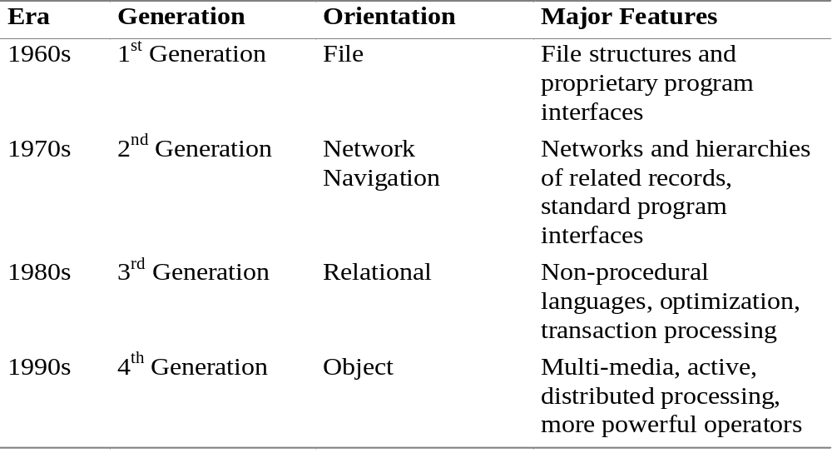
Database Technology Evolution
Notes:
The first generation supported sequential and random searching, but the user was required to write a computer program to obtain access.
The second generation products were the first true DBMSs as they could manage multiple entity types and relationships. However, to obtain access to data, a computer program still had to be written. Second generation systems are referred to as “navigational” because the programmer had to write code to navigate among a network of linked records.
Third generation systems are known as relational DBMSs because of the foundation based on mathematical relations and associated operators. Optimization technology was developed so that access using non-procedural languages would be efficient.
Fourth generation systems can store and manipulate unconventional data types such as images, videos, maps, sounds, and animations. Because these systems view any kind of data as an object to manage, fourth generation systems are sometimes called “object-oriented” or “object-relational”. In addition to the emphasis on objects, the Internet is pushing DBMSs to develop new forms of distributed processing.

Slide 44
Database Management System (DBMS)
User Query &
Reporting
Facilities
Data
Dictionary
Subsystem
Data
Dictionary
Users
Securities &
Integrity
Subsystem
Application
Program
Development
Facilities
Database
Access
Subsystem
Database
Programmers

Slide 45
DBMS supports
Creating databases
Writing applications
  Programming Languages
    Procedural
    Non-procedural
Accessing data
  Accessing tools
Security/Integrity management
  Data access control
  Data validation, concurrency control

Slide 46
Transaction Processing
Transaction: unit of work that should be reliably processed
Control simultaneous users
  Recover from failures
Examples:
  ATM,
  shopping cart
Notes:
Example transactions: ATM, shopping cart
Major difference between enterprise and desktop DBMSs: transaction processing ability; major cost difference

Slide 47
Database Management System (DBMS)
Enterprise DBMSs
Desktop DBMSs
Embedded DBMSs
Major part of information technology infrastructure
Notes:
DBMS (Database Management System): collection of components (mostly software)
Enterprise DBMS: supports mission critical information systems; very large dbs, many users, tight performance requirements
Desktop DBMS: end user departments and small databases
Embedded DBMS: resides in a larger system, either an application or a device such as a Personal Digital Assistant or smart card. Embedded DBMSs provide limited transaction processing features but have low memory, processing, and storage requirements.
Features common to most DBMSs: database definition, non procedural access, application development, procedural language interface, transaction processing

Slide 48
DBMS Marketplace
Enterprise DBMS
  Oracle: dominates in Unix; strong in Windows
  SQL Server: strong in Windows
  Informix: significant Unix market share
  DB2: strong in mainframe environment
Desktop DBMS
  Access: dominates
  FoxPro, Paradox, Approach, FileMaker Pro
Notes:
According to Gartner Dataquest, sales of enterprise database software reached $8.8 billion in 2001, a 20.8% increase since 1998 but only a 1.4% increase since 2000. Enterprise DBMSs use mainframe servers running IBM’s MVS operating system and midrange servers running the Unix and Microsoft NT operating systems. Electronic commerce on the Internet has rejuvenated the market for enterprise database software. Before the advent of electronic commerce, enterprise DBMSs were becoming commodities and sales growth was stagnant. After the Internet and telecom slowdowns, database software sales have slowed again as business capital spending has decreased. For future sales, IDC projects sales of enterprise DBMSs to reach $20 billion by 2006.
According to Gartner Dataquest, four products dominate the market for enterprise database software as shown in Table 1-3. Although IBM holds the largest market share, Oracle dominates the faster growing Unix market. IBM’s total market share is partially due to its acquisition of Informix in 2001. The overall market is very competitive with the major companies and smaller companies introducing many new features with each release.

Slide 49
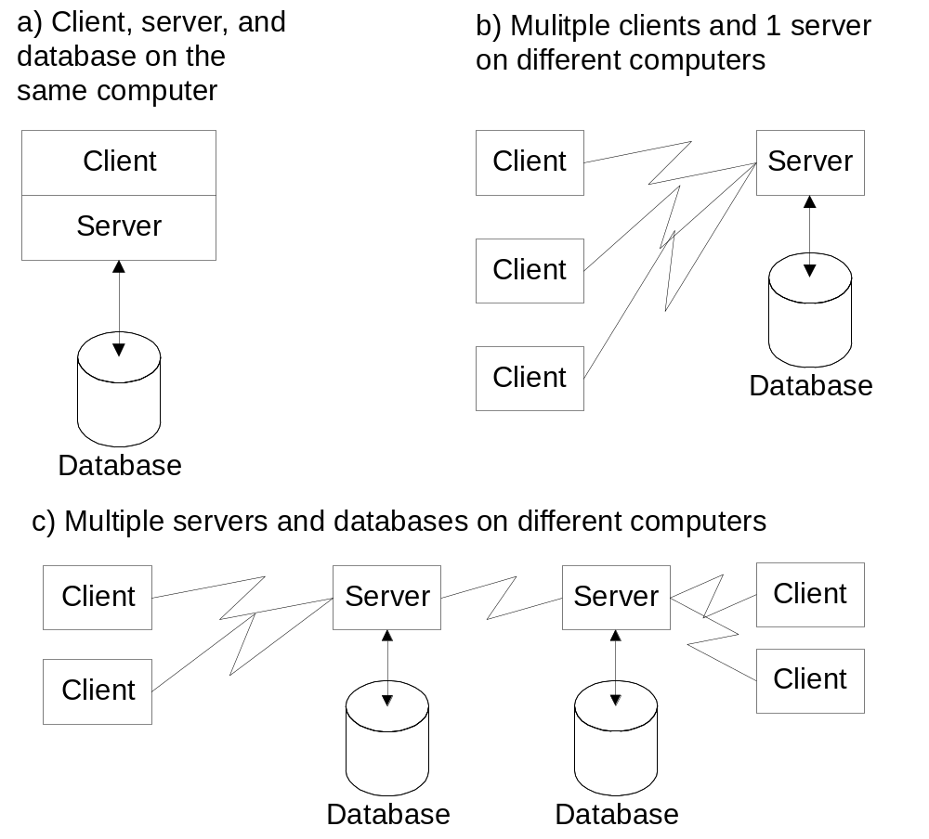
Client-Server Architecture
Notes:
Client-Server Architecture: an arrangement of components (clients and servers) and data among computers connected by a network. The client-server architecture supports efficient processing of messages (requests for service) between clients and servers.
To improve performance and availability of data, the client-server architecture supports many ways to distribute software and data in a computer network. The simplest scheme is just to place both software and data on the same computer (Figure 13(a)). To take advantage of a network, both software and data can be distributed. In Figure 13(b), the server software and database are located on a remote computer. In Figure 13(c), the server software and database are located on multiple remote computers.

Slide 50
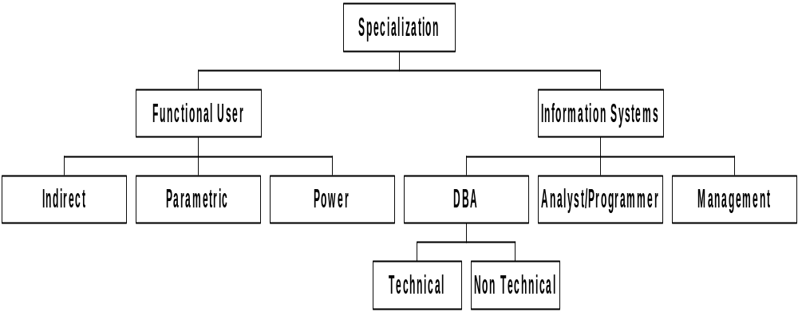
Organizational Roles
Use data extracted
from a database
Business rules,
training
Performance, security
Notes:
Because databases are pervasive, there are a variety of ways in which you may interact with databases. The classification in Figure 14 distinguishes between functional users who interact with databases as part of their work and information systems professionals who participate in designing and implementing databases. Each box in the hierarchy represents a role that you may play. You may simultaneously play more than one role. For example, a functional user in a job such as financial analysis may play all three roles in different databases. In some organizations, the distinction between functional users and information systems professionals is blurred. In these organizations, functional users may participate in designing and using databases.
Functional users can play a passive or an active role when interacting with databases. Indirect usage of a database is a passive role. An indirect user is given a report or some data extracted from a database. A parametric user is more active than an indirect user. A parametric user requests existing forms or reports using parameters, input values that change from usage to usage. For example, a parameter may indicate a date range, sales territory, or department name. The power user is the most active. Because decision making needs can be difficult to predict, ad hoc or unplanned usage of a database is important. A power user is skilled enough to build a form or report when needed. Power users should have a good understanding of non-procedural access, a skill described in the first part of this book.

Slide 51
Database Specialists
Database administrator (DBA)
  More technical
  DBMS specific skills
Data administrator
  Less technical
  Planning: databases and technology
  Standards setting
  Computerized and non-computerized databases
Notes:
DBA:
- focused on individual databases and DBMSs
- Need strong skills in specific DBMSs
Data administrator
- Planning: databases and technology
- Standards setting
- Computerized and non-computerized databases
Large organizations have separate positions; small organizations combine roles
Both positions require more than 1 db course
- 2nd course
- certification
- lots of experience
- management experience for data administration

Slide 52
Summary
Databases and database technology vital to modern organizations
Database technology supports daily operations and decision making
Nonprocedural access is a crucial feature
Many opportunities to work with databases

